Slide 1
Comparisons of Hail Producing Schemes
Jeremy Corner
December 5th, 2023

Slide 2



Overview
Hail is one of the least understood weather phenomena.
Incredibly costly, with over a billion dollars in damages annually (III, 2023).
Microphysics schemes are designed to handle small-scale processes present in cumulus clouds (including hail).
An analysis of each scheme is necessary to understand the performance (and more importantly the bias).

Slide 3
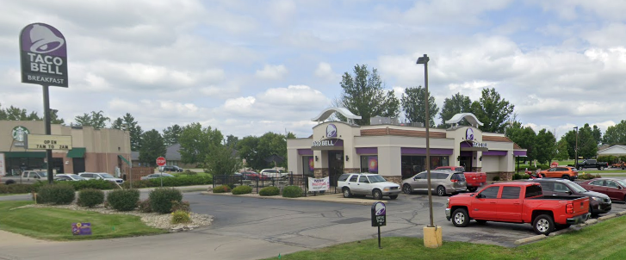

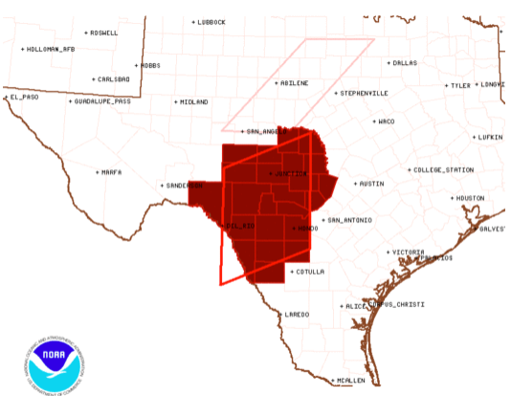
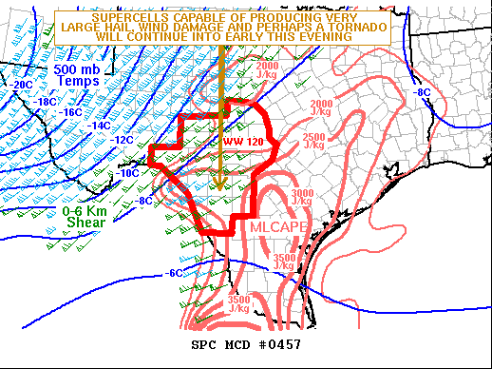
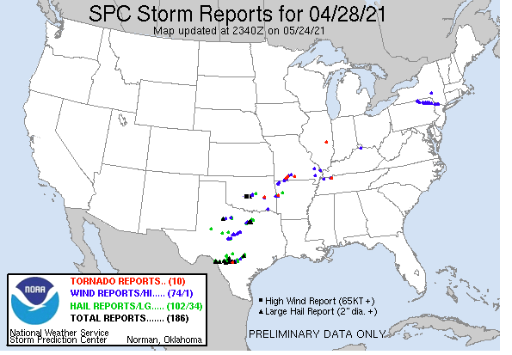
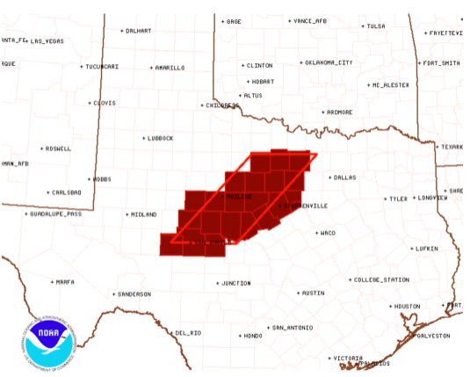
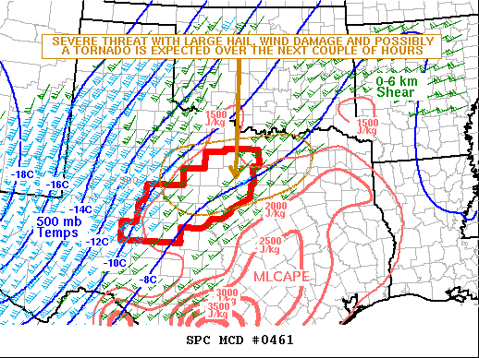
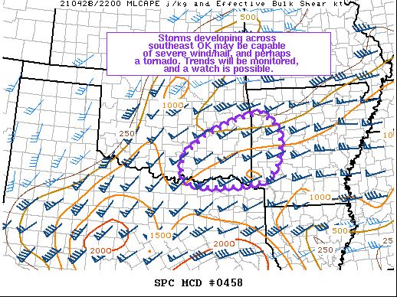
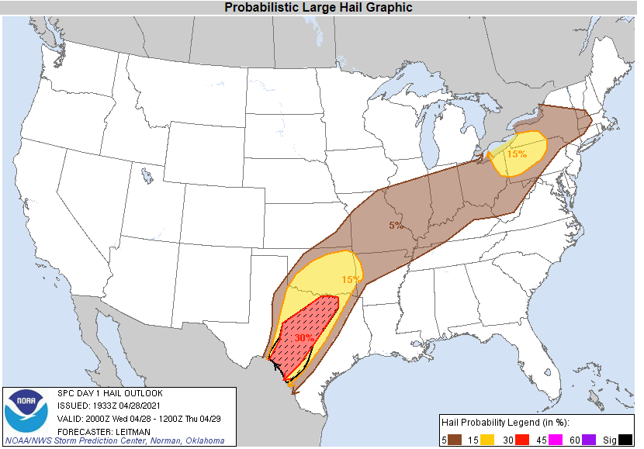
Event Details
28 April 2021 at 18 UTC to 29 April 2021 at 3 UTC
Produce the Hondo, TX 6.4" hailstone
Significant hail also reported in San Antonio, Dallas, and Norman.

Slide 4
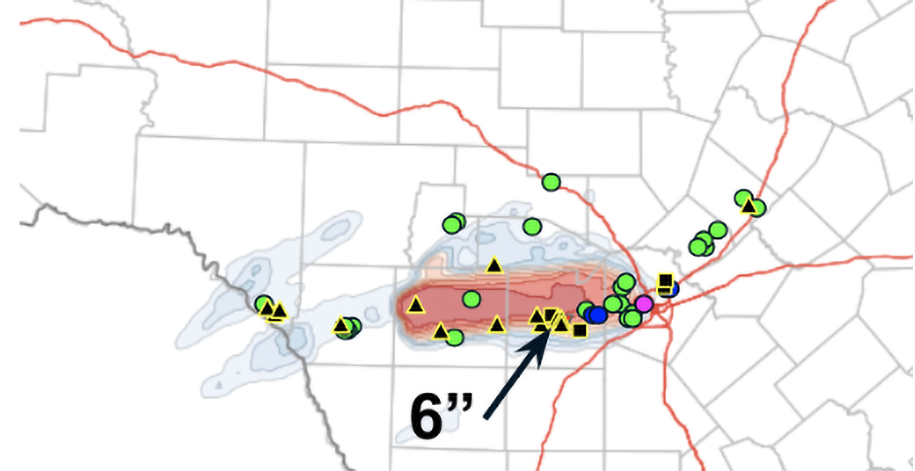
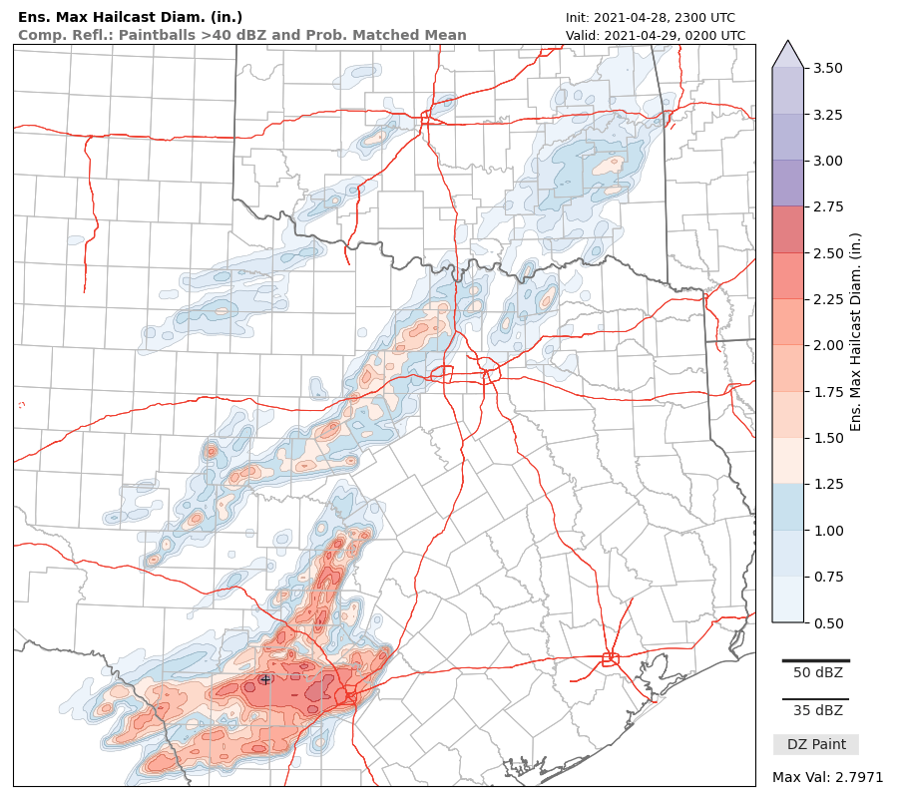
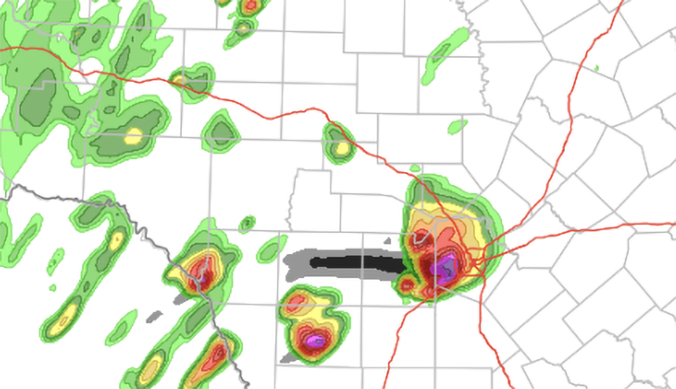
Warn-on-Forecast

Slide 5
WRF Settings
Microphysics schemes tested
NSSL 7-Class Single Moment, NSSL Double Moment, and Thompson (hail)
No Cumulus Scheme as grid spacing is 3.75 km
Everything else is default
Model is initialized at 18 UTC on the 28th
NAM used to fill lateral boundaries

Slide 6
Datasets
WRF Datasets
Three datasets for the different microphysics schemes
Verification Datasets
6-Hour Maximum Estimated Size of Hail (MESH; )
Multi-Radar Multi-Sensor (MRMS) Composite Reflectivity
Comparison Datasets
High-Resolution Rapid Refresh (HRRR)

Slide 7
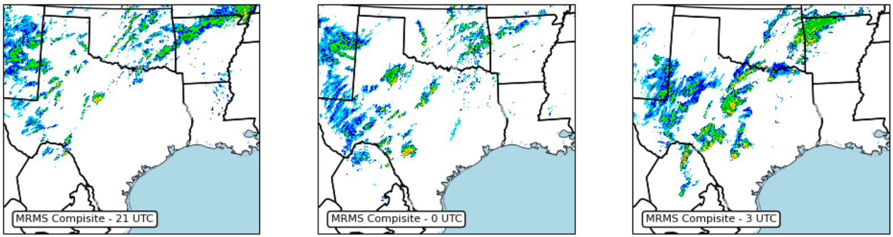
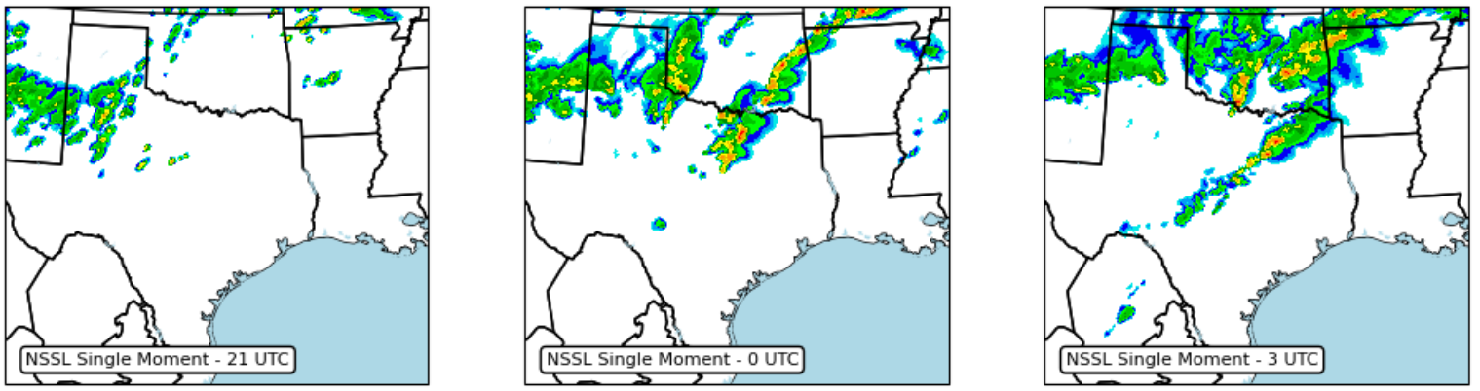
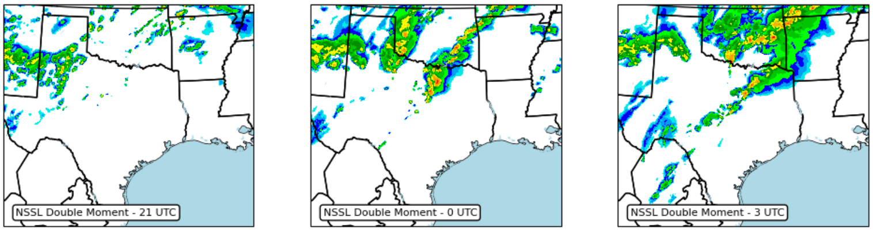

Slide 8
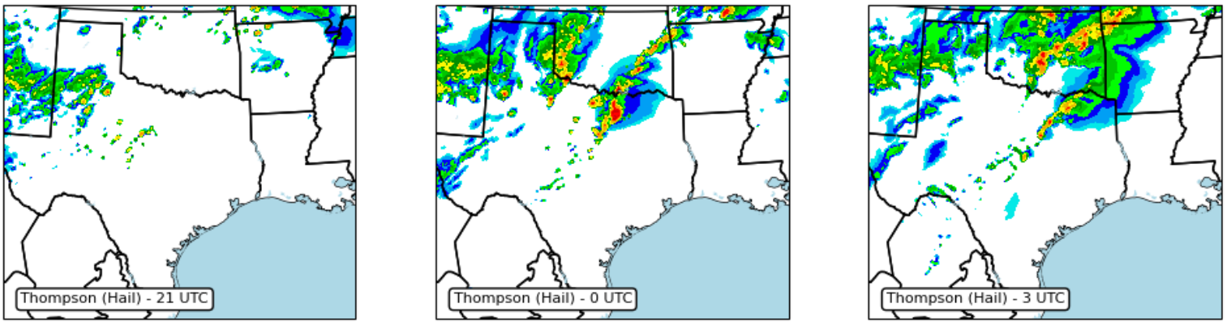
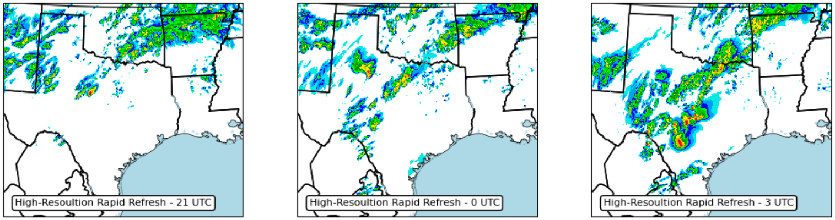

Slide 9
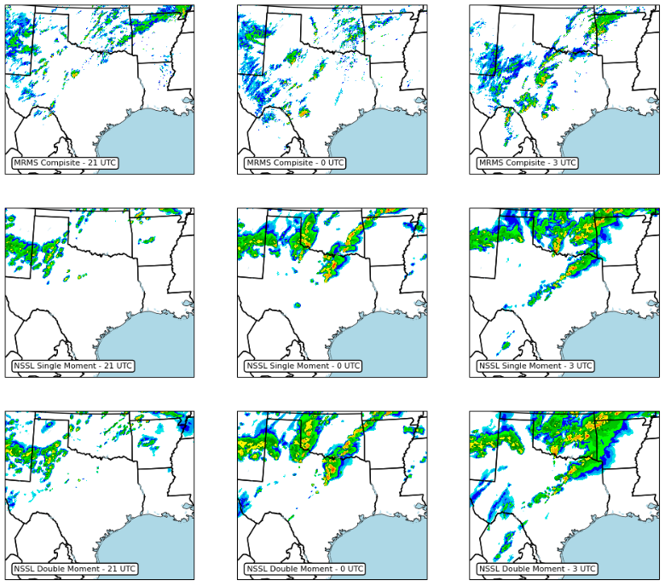
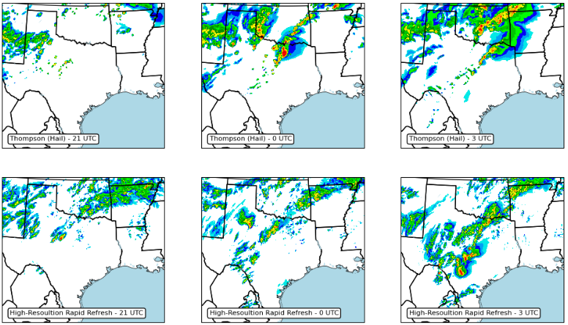

Slide 10
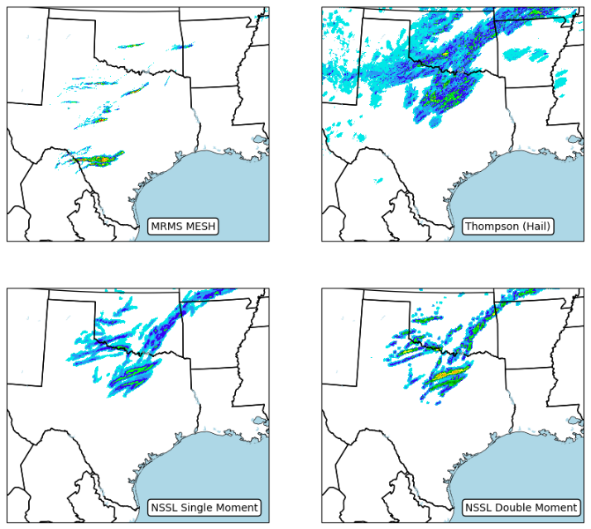

Slide 11
Hail Comparisons – Ground-Truth
Dataset | Hail Size (Inch)
Observations | 6.4
MRMS MESH | 3.76
NSSL Single Moment | 1.13
NSSL Double Moment | 2.21
Thompson (Hail) | 2.35

Slide 12
Conclusions
CAMs (including WRF) high bias in over initiation convection.
Microphysics schemes well underestimate hail size.
NOTE: Not possible to make any broad claims as this is only one event. However, these trends are seen normally throughout the CAMs.

Slide 13
References
NOAA/National Severe Storms Laboratory (NSSL). 2022. TORUS_2022: MRMS Maximum Estimated Size of Hail (MESH) Data. Version 1.0. UCAR/NCAR - Earth Observing Laboratory. https://doi.org/10.26023/EE1C-D9X9-X80C.
https://www.iii.org/fact-statistic/facts-statistics-hail

